Slide 1
Development Systems Hackathon
Hackathon 2025
02 December 2025

Slide 2
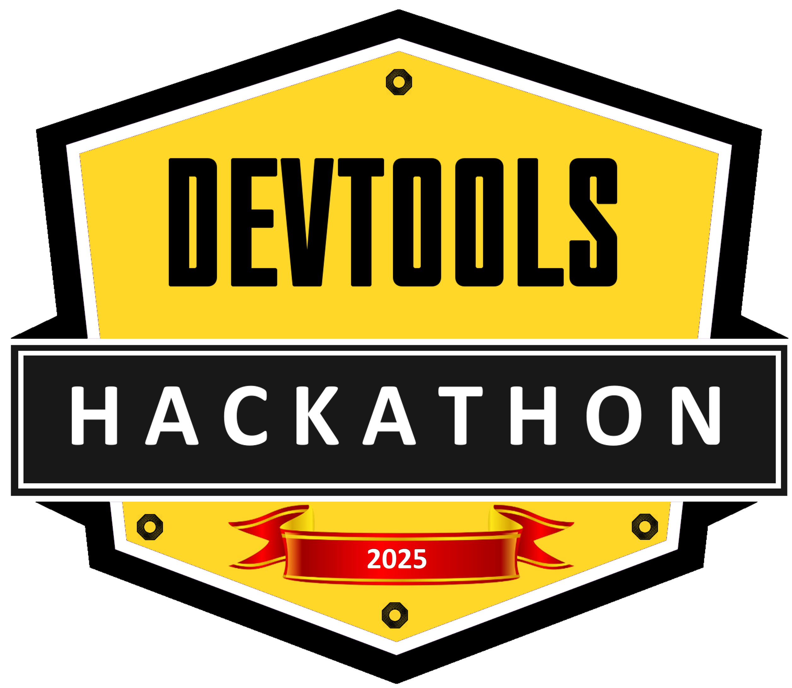
PyKit Explorer – Balancing Bot Demo
Don't Fall for It
Ross Satchel – Liam Sheard

Slide 3
Balancing Bot- Challenge & Solution
Legacy demo kits: fragile, scarce, hard to replicate
Barriers: cost, complexity, shipping, expertise
Our answer: PyKit Explorer (Ruler Kit) - as a Demo!
Affordable, accessible, instantly deployable
Modular—3D printed parts, easy customization
Programmed in Python (CircuitPy)

Slide 4
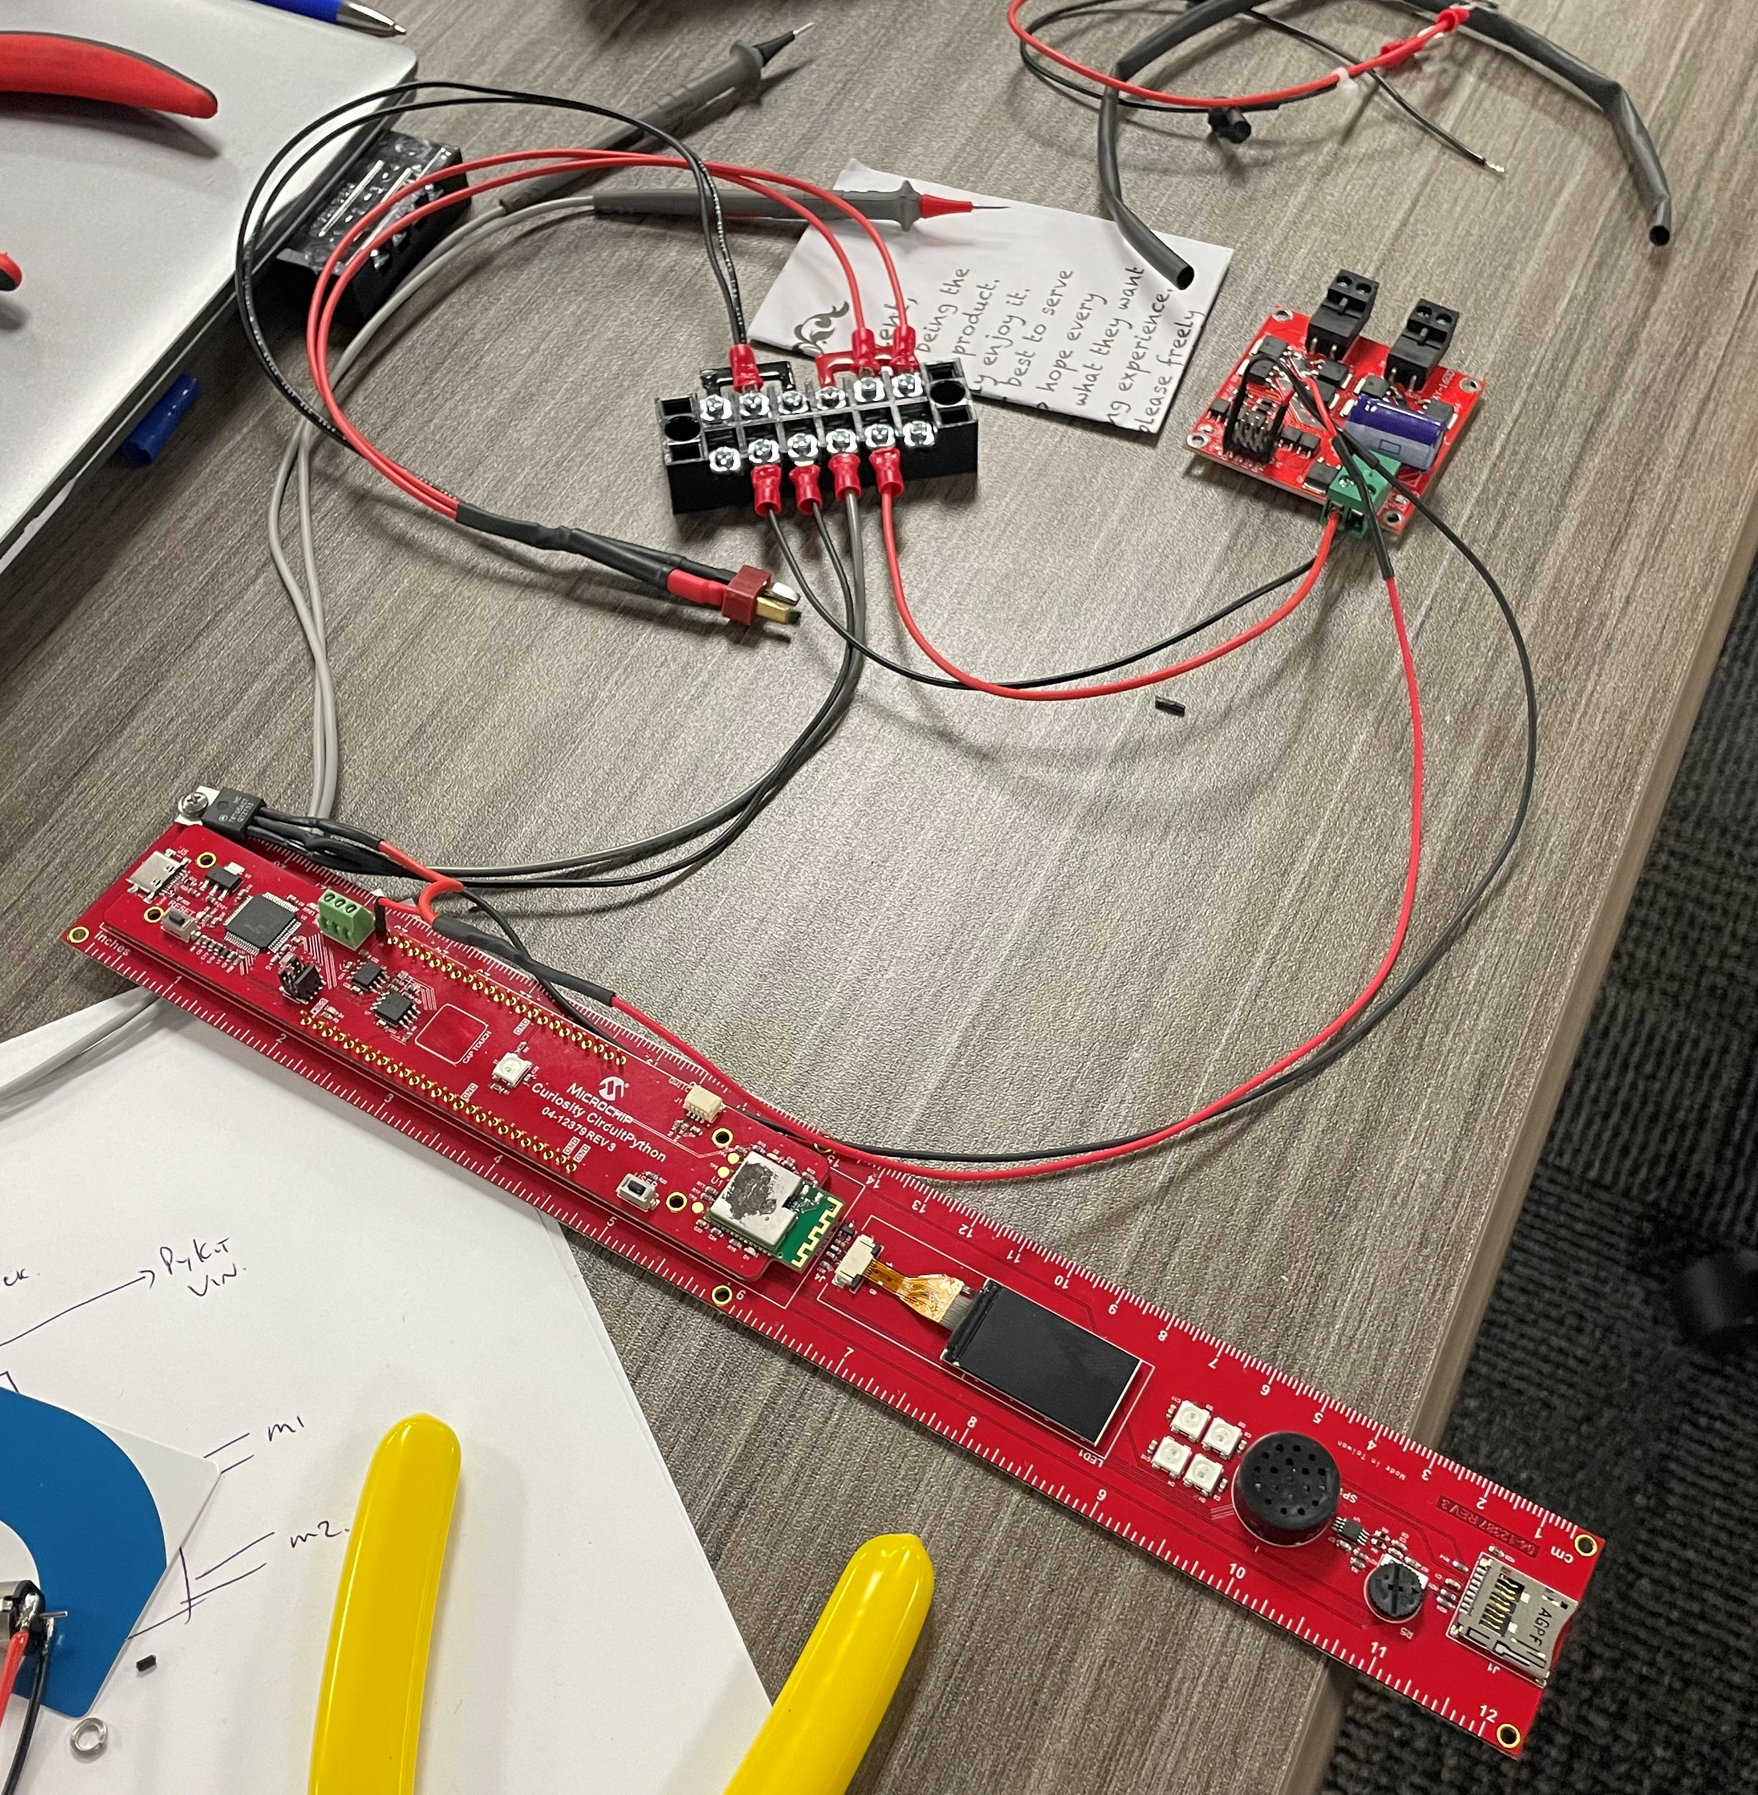
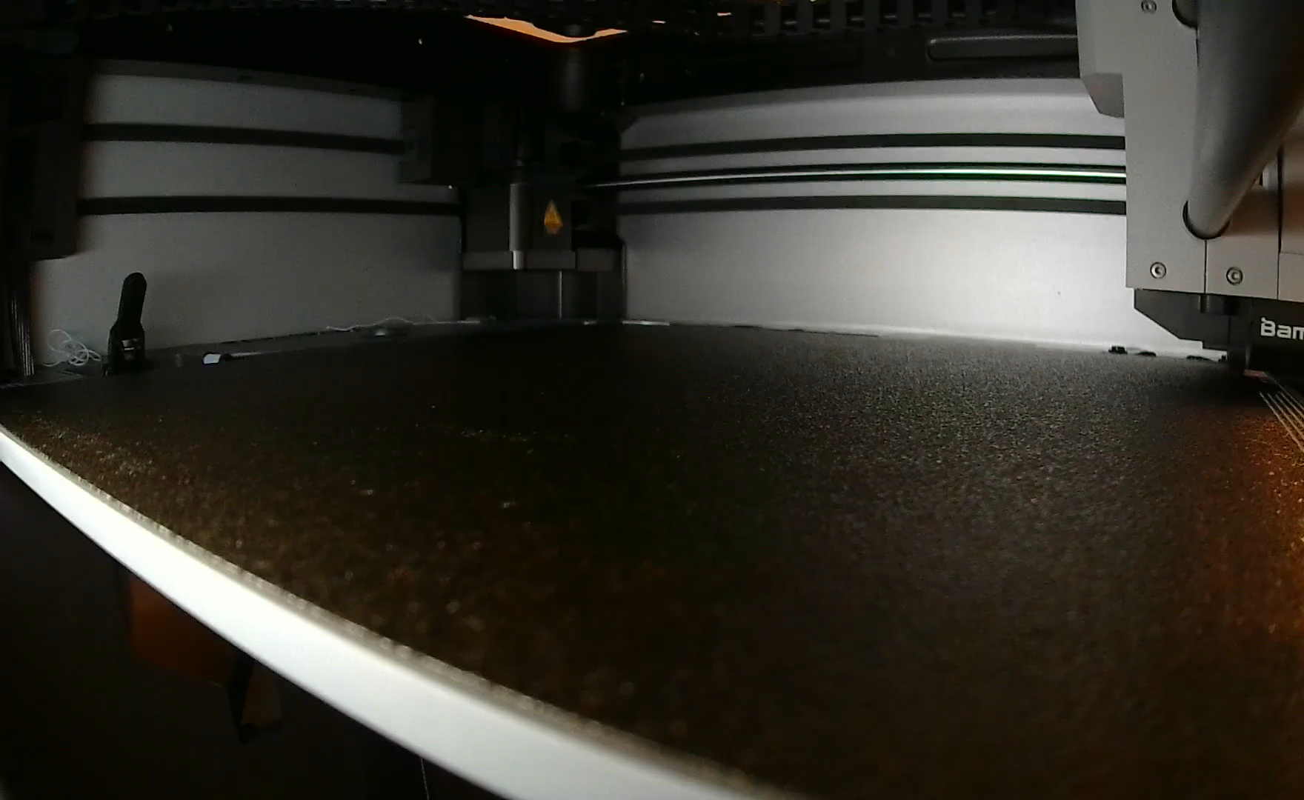
Impact & Inspiration
Not just a “toy”—hands-on controls, multi-discipline learning.
Empowers students, teachers, ambassadors—globally!
Scales from intro lessons to advanced projects & clubs
Built in under 24 hours—imagine what’s possible next!

Slide 5
Next Steps & Vision
Course/demo videos & shared 3D models
Full build guides with BOM & sourcing links
Exploring Bluetooth for wireless control/upgrades
Let’s democratize engineering education together!

Slide 6
THANK YOU

